Slide 1

Your past, your present and your future

Slide 2


Slide 3
IDEA
What is Capsulefy?

Slide 4





Time capsule

Slide 5


Payment plans
 | Free | Premium
Price | 0 € | 11.99 €
Storage | 20 MB/user | 500 MB/capsule
Social network and email integration
Capsule scheduling | 1 year | No limit
Capsule expiration | 6 months after release | No expiration
Modular and private capsules

Slide 6



We offer…
Social network integration
Email integration
Deadman switch

Slide 7
DEMO
How does the system look like?

Slide 8
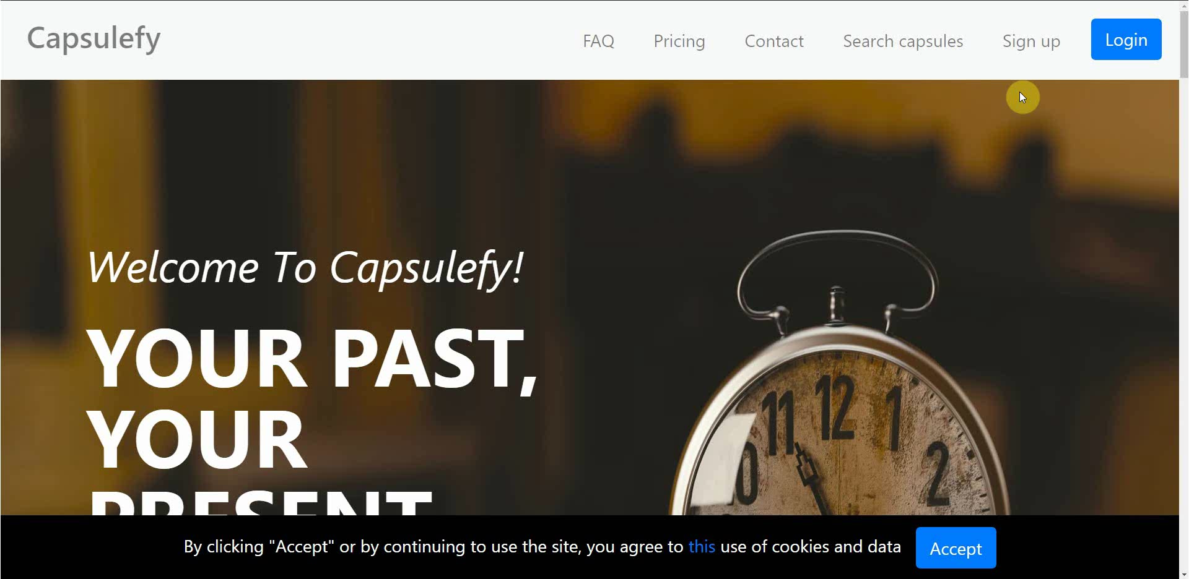
No logged user – Sign up

Slide 9
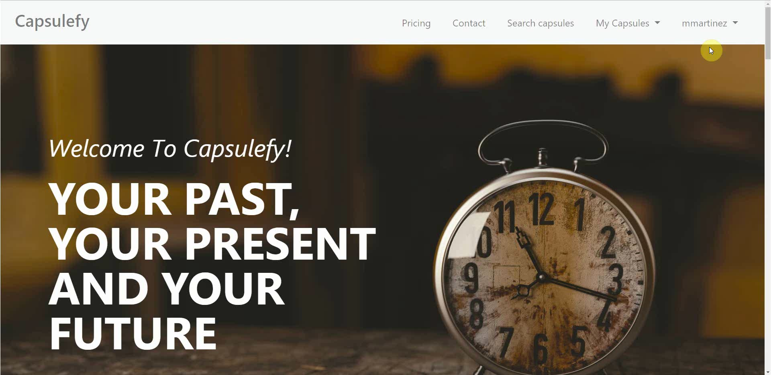
Logged-in user – Connect to Twitter

Slide 10
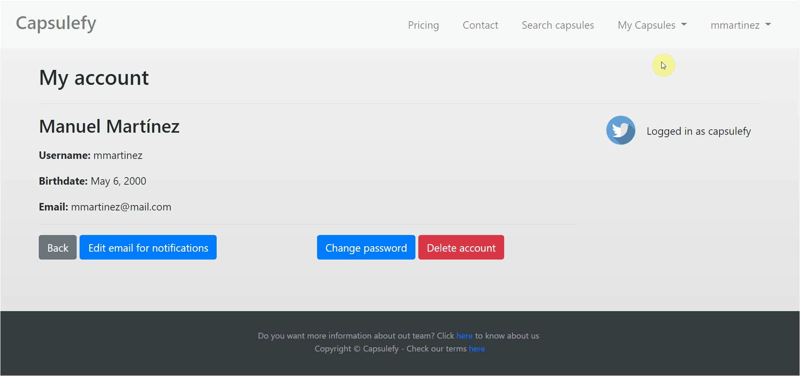
Logged-in user – Create capsule

Slide 11
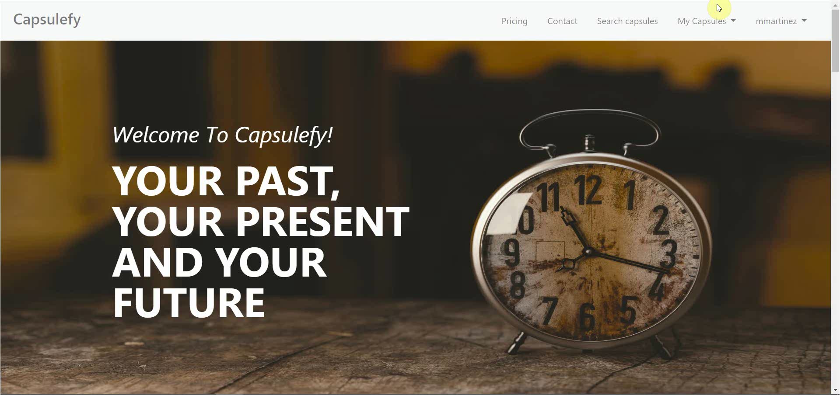
Logged-in user – Refresh timer

Slide 12
TEAM
Who is behind?

Slide 13













Pablo Rebollo
Project manager, backend developer
Juan Rodríguez
Requirements engineer, backend developer
Adrián Cantón
Business manager, full-stack developer
Rafael Fresno
Backend developer, API integration
Daniel Carpio
Analist,
frontend developer

Slide 14
Try it now!

Slide 15
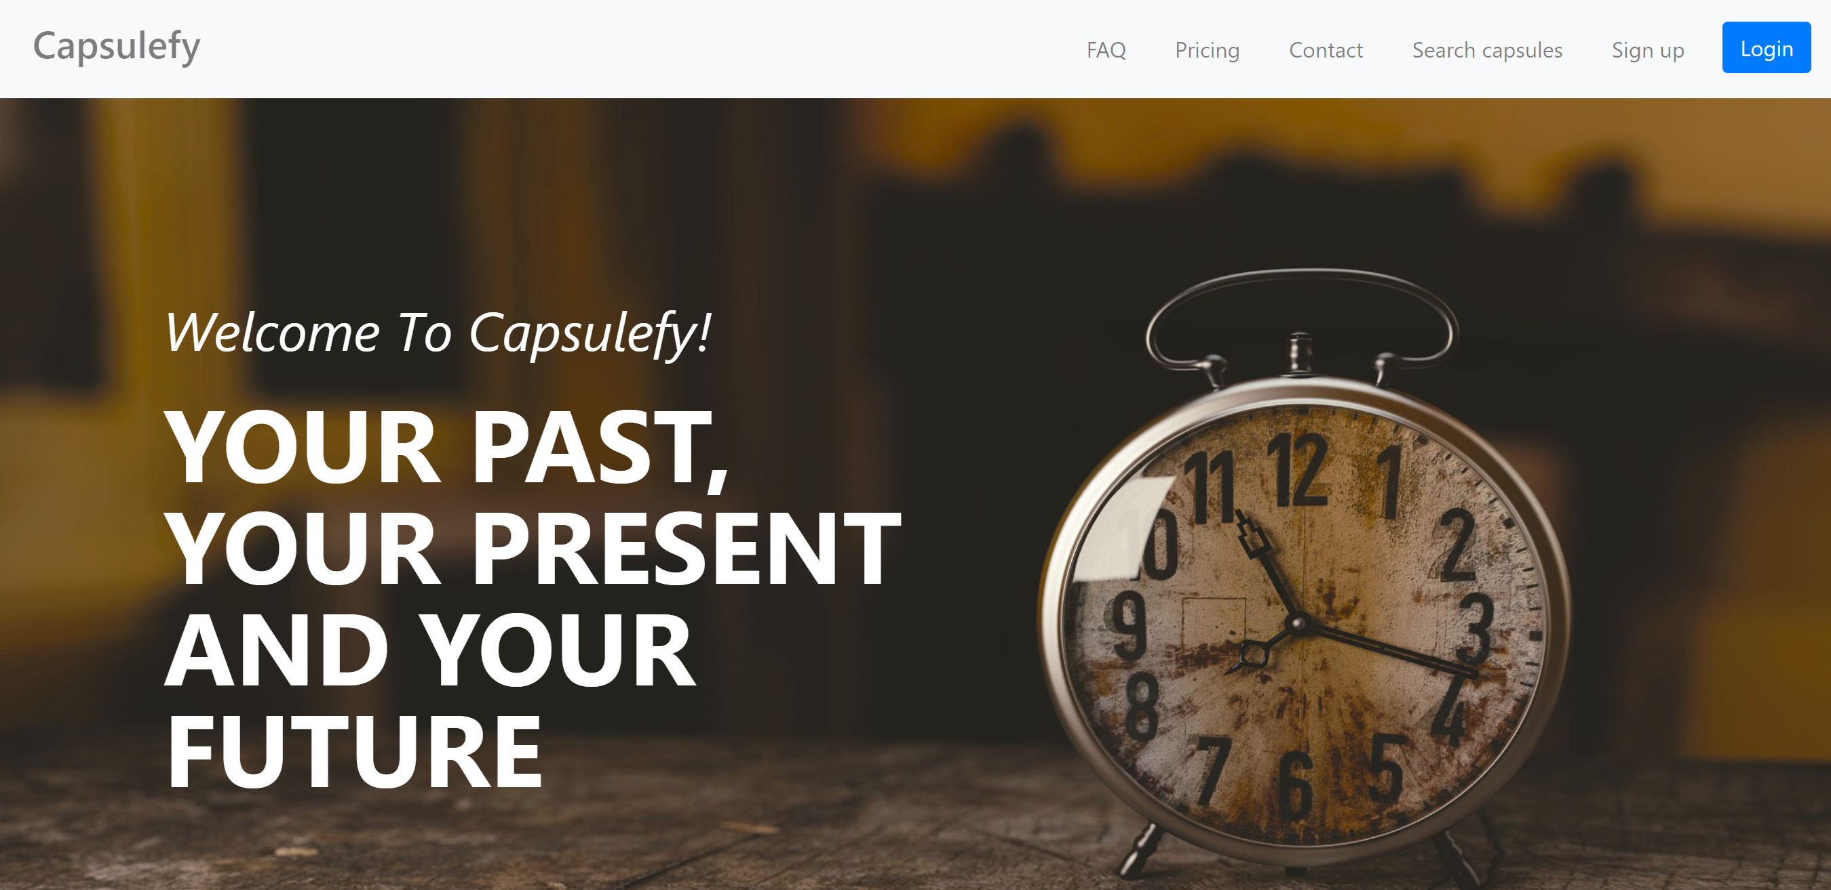
https://capsulefy.herokuapp.com

Slide 16
Thanks!
https://capsulefy.herokuapp.com
Landing page: https://capsulefy01.herokuapp.com
Contact email: capsulefy.communications@gmail.com
GitHub releases: https://github.com/pabreblob/capsulefy/releases

